Slide 1


Initial Observations Toward Enabling Key Objectives for NFP
April 30, 2014

Slide 2
Agenda
1
An Enhanced Aditi and “Systems of Engagement”
2
NFP 360: Our Top Level Understanding
3
Enabling Key Objectives and On-boarding Blueprint
4
Team
5
Next Steps

Slide 3
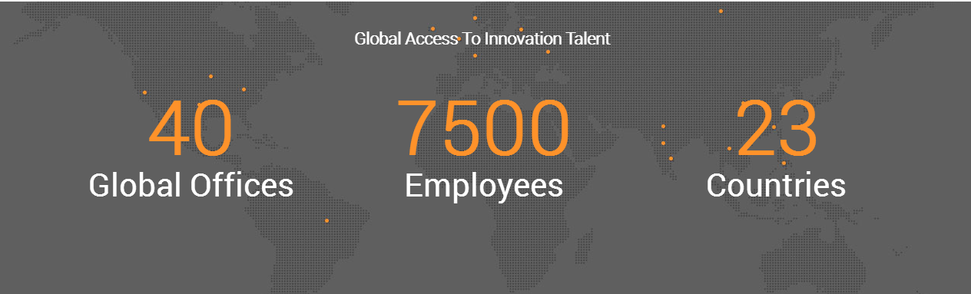
An enhanced ADITI + Symphony Teleca:
EXPANDED ACCESS TO Global talent
Buenos Aires (DC)
Boston Burlington
Chicago Detroit
Mountain View (HQ)
Nashville (DC)
New Jersey
New York
Plano
Seattle
San Diego
Westford, MA
Providence, RI
Berlin Lodz (DC)
London Malmo
Nizhy Novgorod (DC)
Nuremberg
Nuremberg
Oulu
Reading (DC)
Richmond
Rodionova
Tampere
Winchester
Bangalore (DC)
Beijing (DC)
Chengdu (DC)
Chennai (DC) Coimbatore (DC)
Gurgaon (DC)
Geyongi-do Hyderabad (DC)
Mumbai (DC)
Pune (DC)
Seoul
Tokyo

Slide 4



Our focus is Systems of engagement; CRM Is the glue
OMNI-CHANNEL
Connect the Channels
SINGLE VIEW OF CUSTOMER
Connect the Context
z
PERSONALIZATION
Connect to the Customer
SOCIAL MEDIA
MOBILE
BIG DATA
DATA QUALITY AND GOVERNANCE
MARKETING AUTOMATION
MULTICHANNEL MARKETING
WEB/ E-COMMERCE
KIOSKS
SOCIAL MEDIA ANALYTICS
PRODUCT/ PRICING ANALYTICS
SOCIAL/ MOBILE COMMERCE AND ENGAGEMENT
PREDICTIVE ANALYTICS
CONNECT THE PLATFORMS
CONNECT THE EXPERIENCES
CLOUD
API
CUSTOMER EXPERIENCE RESEARCH
INTERACTION DESIGN
VISUAL DESIGN
INFORMATION ARCHITECTURE

Slide 5
NFP 360: Our top level understanding*
CHALLENGES
Scale on-boarding of Firms cost-effectively
Increase port run-rate
Better manage Firm customizations
Improve usability of end user experience
Establish consistent Firm and end-client data within and across lines of business
Establish best possible sequence for porting/re-working legacy functionality
Create right architecture and establish governance
DESIRED GOALS
Scalable off-shore on-boarding team and streamlined solution
Data integrity across systems
Roadmap and process for identifying and managing enhancements
Manage toward an architecture and create governance team(s) to handle change management and related processes
*Based on limited discovery and input to date; would recommend additional discovery meeting with a limited set of NFP 360 team members to tighten this understanding

Slide 6
Enabling key objectives
1 – Scalable On-Boarding Blueprint
2 – Data Integrity Across Systems
3 – Roadmap for System Enhancement
4 - Architectural Guidance and Governance
Data Validation and migration (ETL)
Porting of logic (including workflow)
Customization Framework
Cost-effective (flexible pricing!)
Define, manage data flow within NFP 360 and between NFP 360 and existing systems (such as Smart Office)
Manage, improve tools/processes for monitoring data quality
Define future state of data architecture for NFP 360 and master data
Short-term enhancements including usability and visual force improvements
Roadmap for sequencing porting of features from existing systems
Architectural integration of NFP 360 into future state systems (eg. MDM)
Architecture advisory as needed
Establish right degree of governance, possibly to include:
Mgmt. of compliance (privacy)
Security processes
Problem escalation
Performance monitoring
Aditi proposes to focus initially on helping to build out a streamlined and cost-effective off-shore on-boarding process.

Slide 7
Technology options for Scaling on-boarding
1 - Onboarding Data Contract
2 - Data Validation and Compliance
3 - Intelligent Data Mapping
4 – Data Integrity
and Sync
5 - Adaptive and Business Logic Compliant UI
Define contract format (e.g. csv, webservice, RDBMS) with flexibility to define custom data attributes, enabling changes in underlying SFDC schema
Destination validation (SFDC)
Pre-loading validation (e.g. SFDC onboarding web service with data pre-load validation, rollback and return load statistics)
As Firm data is populated in Salesforce prevent duplication of existing data
Call to necessary systems build appropriate object relationships (Account, Contact, Opportunity, etc)
Define data master schema components
Define integration contracts
Build custom integration(s) (e.g. custom webservices) or leverage existing tools (e.g. commercial ETL tools)
Firms with specific business logic and/or look & feel are able to better define UI layouts (conditional field logic), business logic (e.g. XML driven UI)
Increase user adoption, enhance usability and workflow management
Reduce time and effort to onboard firms, ensure Firm data compliance, manage Firm business logic at scale.

Slide 8

on-boarding Example Solution
1 - Onboarding Data Contract
2 - Data Validation and Compliance
3 - Intelligent Data Mapping
4 – Data Integrity & Synchronization
5 - Adaptive and Business Logic Compliant UI
Firms
NFP 360 / Salesforce.com
Existing Systems
JSON message
A
Smart Office
Web Services
B
1
2
C
Data Integration & Synch
Other Existing Systems
3
4
Triggers
(account, contact, oppty, quote, custom…)
Tools may be deployed to facilitate JSON, Web services, and data integration utility
Adaptable UI
Optionally deploy UI toolkit
5
Notes:
Let us know if you want to say something Deepak ☺

Slide 9



Technology Team
Brian Clift has served over the past 20 years as a architect, lead developer, independent consultant and project manager. In the most recent 7 years, Brian has served as a Salesforce.com lead developer, project manager and architect on large, complex and custom projects for companies such as Staples, Hewlett-Packard, Level 3 Communications, Motorola-Mobility, Qualcomm, Citrix and others.
Jonathan has been engaged in technology marketing, product management, and business development for over 20 years and is expert in online services business. He was a Co-Founder VP at Jobster.com; Director at eShop (acquired by Microsoft in 1996), and a Director of Product Management for 8 years at Microsoft.
Brian Clift,
Senior Salesforce
Technical Consultant
Jonathan Weinstein
Business Consultant
A multi-skilled Salesforce professional with good all-round Functional and Technical expertise. Extensive experience on Salesforce - sales cloud, service cloud and force.com platform. Recent experience with clients like Sony, Cognizant, VMWare Currently leading a approx. 20 developer Salesforce team at Sony. Led Salesforce center of excellence team at HCL, grew team from 1 to 150 member team.
Experience in End to End Implementation, Integration and Production Support. Proficient in using Apex and VisualForce. Experience in migrating data using Data Import Wizard and Data Loader. Profound knowledge in Workflow Rules, Validations and Formulas in Salesforce.
Onkar Kumar
Senior Salesforce Architect
Chandra Kanth
Salesforce Developer

Slide 10

Managing your Corporate Master Data Assets
The Benefits of Riversand Master Data Management Solutions
Notes:
This PowerPoint Template includes a series of slide masters with predefined layouts and color schemes for formatting slides
Slide Masters are displayed when you right click on a slide and select Layout from menu

Slide 11





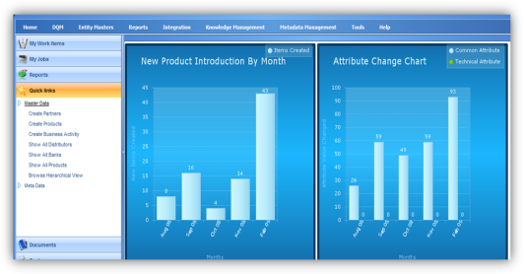



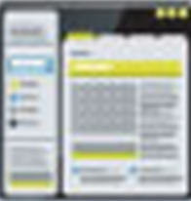



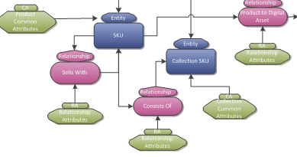
Riversand’s Solution fully enables multi-domain MDM for NFP’s Lines of Business
PRODUCT
PRODUCT TYPE
REPS/AGENT
HR REP
Data
Globalization
Entity
Explorer
CUSTOMER
ACCOUNTS
SPONSOR
CUSTODIAN
Reporting &
Analysis
Workflow
FIRM
BRANCH
Matching &
Merging
Performance &
Scalability
Data
Governance
Data
Integration
Relationship
Management
Flexible
Data Model

Slide 12
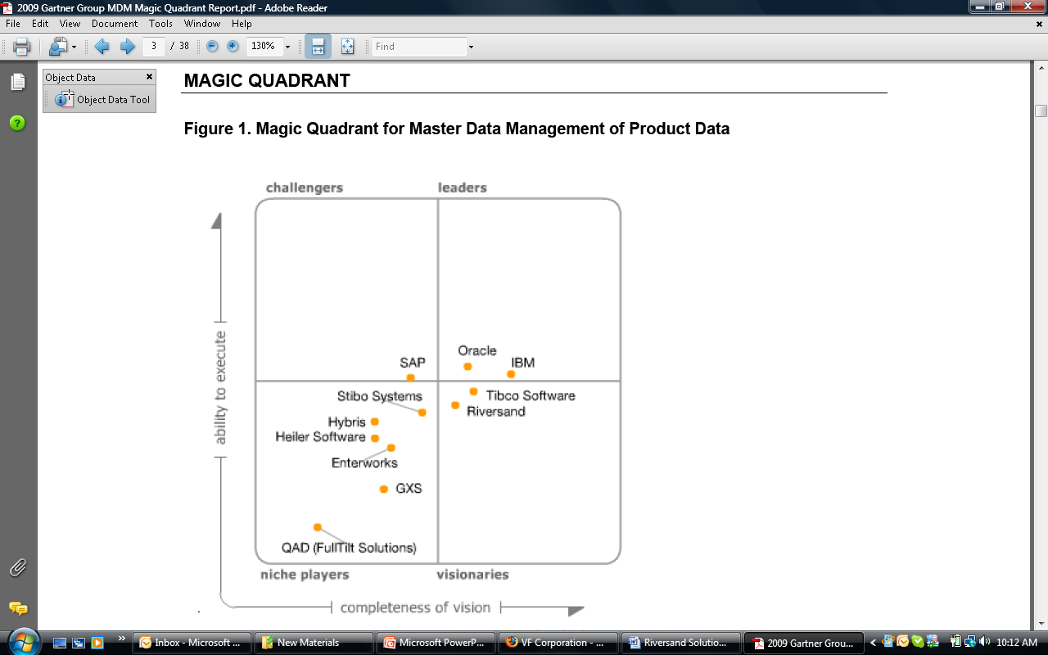
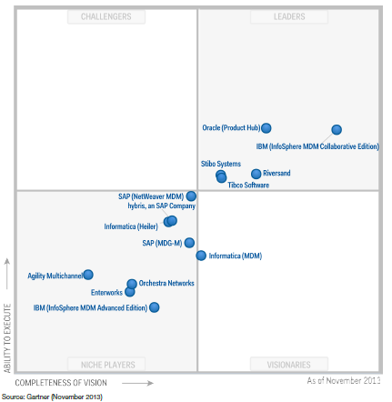
Riversand: the highest-rated pure-play MDM provider
Riversand established as the most innovative company in the “Leaders” Quadrant
Gartner’s MQ report highlights Riversand's strengths:
Business Strategy
Market Growth/Momentum
“Leader" functionality and product strategy
References and customer base
Solid partner program
2012
2011
2010
2009

Slide 13
Trends in Master Data Management- Build vs. Buy
In 2013, 75% of organizations had purchased or intended to purchase a packaged solution with only 10% claiming they would build one in-house (down from 18% in 2008).¹
The median number of systems that generate master data was 15 with 43% having between 10 and 30 systems.¹
56% of companies prefer a unified master data platform while 27% seek a solution optimized for a specific data domain.¹
23% of companies reported that MDM was now a well-established activity in their business (13% in 2008).¹
In 2013, 10% of Businesses estimate the annual costs of poor data is between $ 1 million and $ 10 million.(up from 4% in ‘12)¹
1 Source - “The Adoption of MDM by Business Revisited” The Information Difference, July 2013

Slide 14
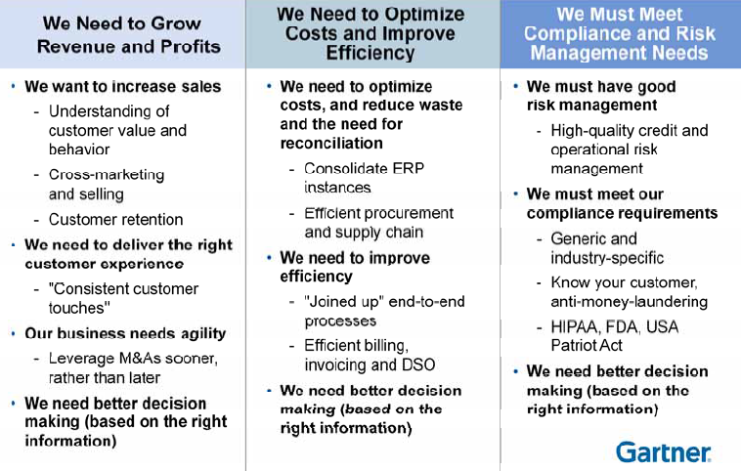
Linking MDM initiatives to Business Value
Notes:
1. This slide needs to be made relevant to NFP’s business and benefits

Slide 15
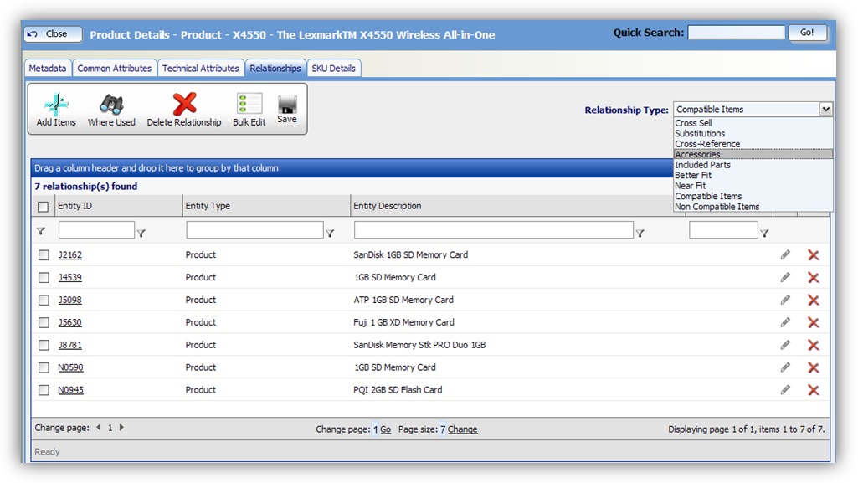
Relationship Management- Example Use Case
Description: Simplified relationship management supports Sales & Marketing and Customer Service initiatives (e.g. suggest a specific policy type based on a customers asset allocation)
Use Case 1- An example would be building an integrated view of customer investments across three lines of NFP business (wealth management, insurance, benefits etc) with data from multiple (5-6) different data sources.
Use Case 2- Using knowledge of customer’s current investments for cross selling other financial products – for e.g. trying to selling auto insurance at discount price to a customer who already has medical\dental insurance plan from NFP

Slide 16
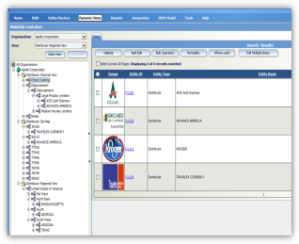
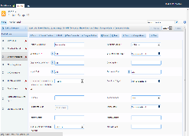
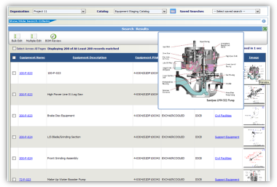
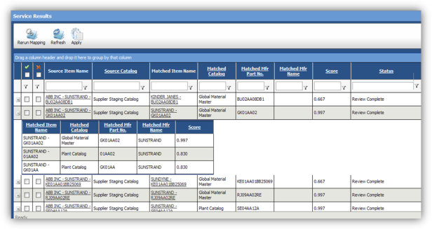
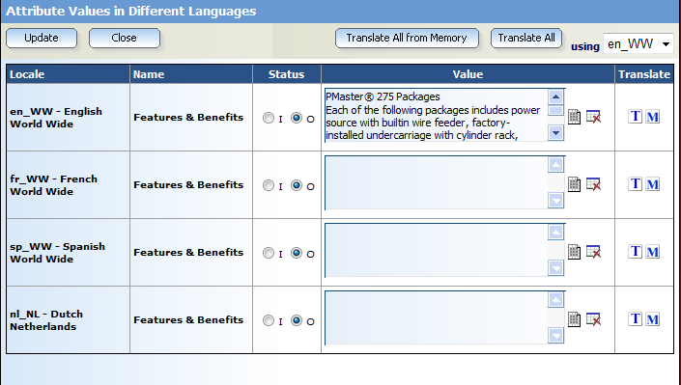
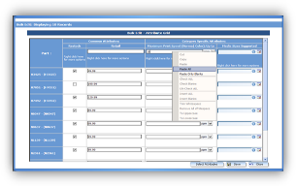
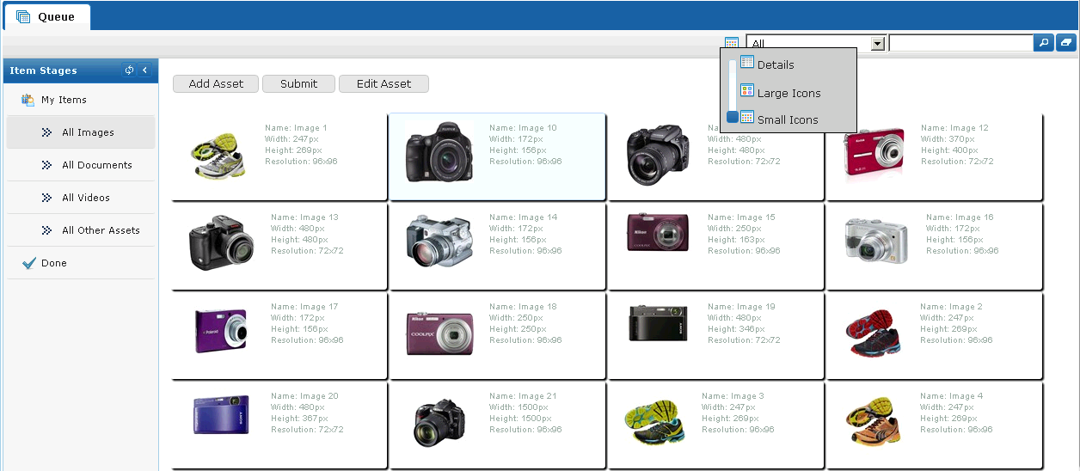
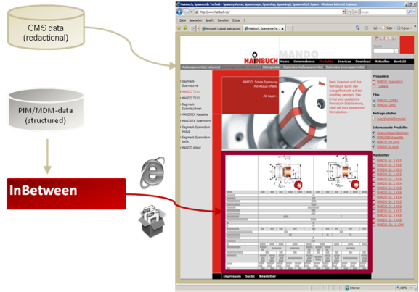
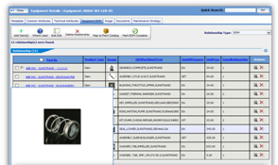
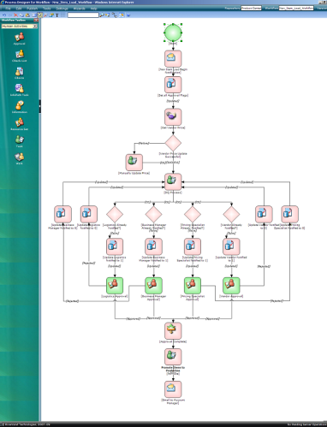
MDMCenter Solution Overview
Data Views
Vendor Portal
Reporting
Advanced Search
Data Quality Management
Data Globalization
Productivity Tools
Digital Asset Management
Print Publishing
Relationship Management
BPM & Workflow
Notes:
Please update this slide to NFP’s needs, if possible.

Slide 17



Examples of Riversand’s Multi-domain MDM clients
World’s Largest Generic Pharmaceutical Manufacturer. Managing Materials, Recipes, Product, and Vendor Master Data.
World’s Largest Apparel Manufacturer. Chose MDMCenter to Manage Vendor, Customer and Product Master Data across 32 brands globally.
A global healthcare company with expertise in medical devices, pharmaceuticals and biotechnology. Selected Riversand for Vendor data management and will be expanding to include other domains.

Slide 18
Discussion and next steps
Feedback on NFP 360 priorities
NFP 360 team input
Firm discovery (rapid)
.

Slide 19
Web | Blog | Facebook | Twitter | LinkedIn

